Slide 1
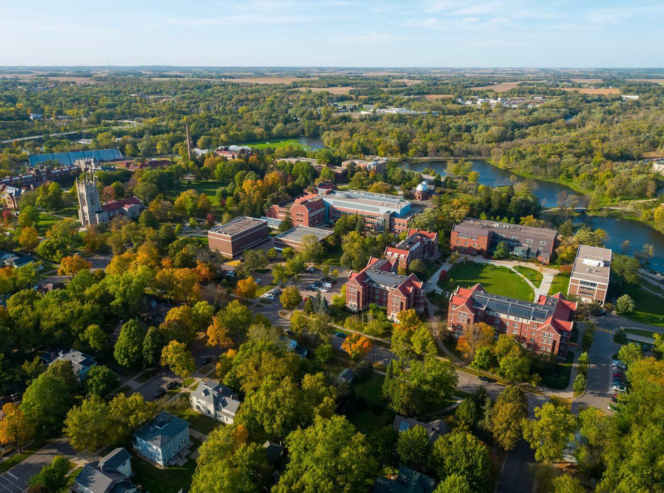
MApping the Past
Notes:
Our project is mapping the past. And im Chloe, this is Peter, this is Mark, this is Zijian. The picture here is the photo of current Carleton campus, which we walk past everyday but rarely know its history.

Slide 2
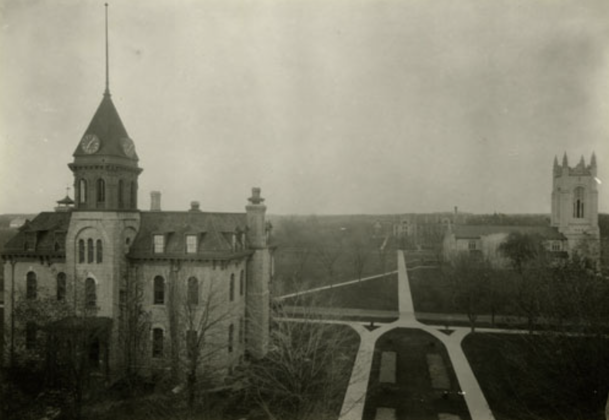
Same spot but Different view
Notes:
During this term, in this class, we get in touch with many historical photos. For example this one, old photo of wills and the church. We still have the same buildings today, but it's a completely different view. So, we want to make a thing to connect the past to now.

Slide 3
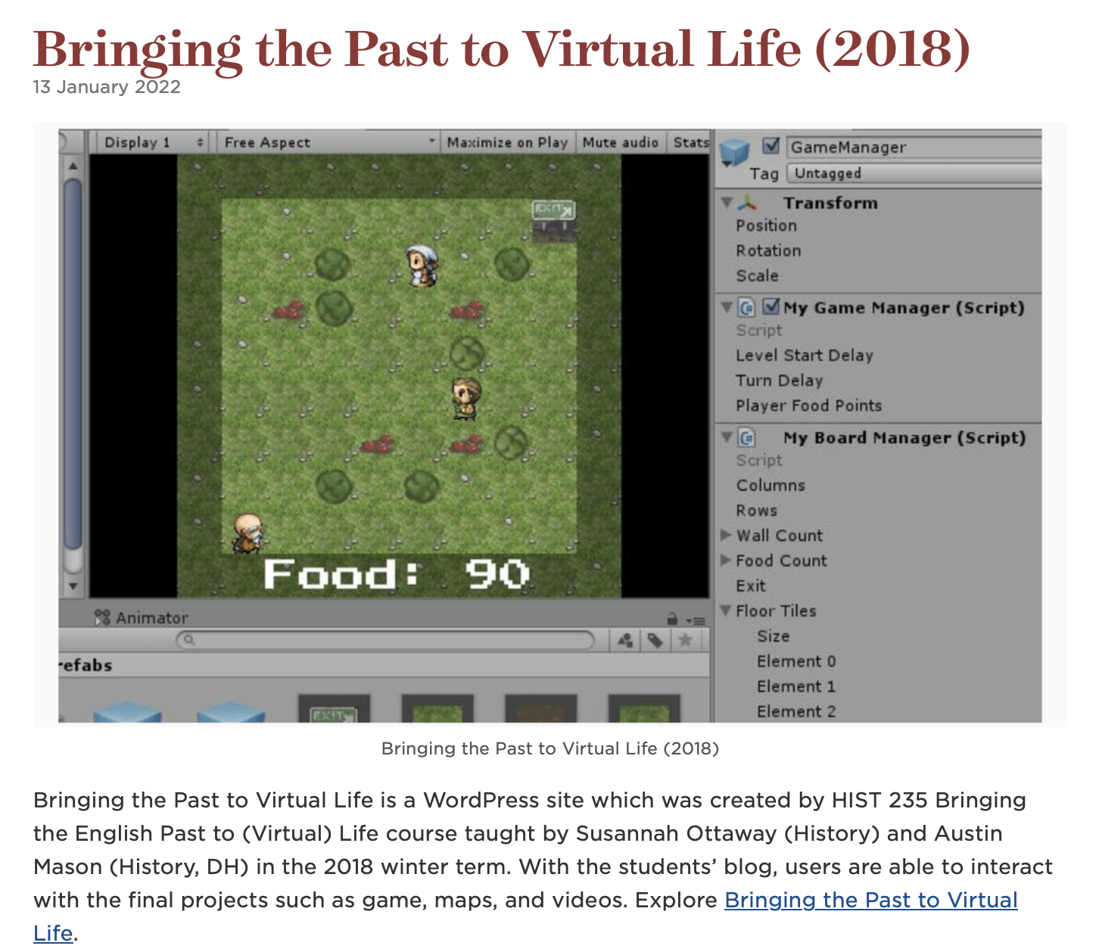
What if Mapping the Past?
Notes:
We are inspired by this project done by history studnets of Carleton. They made an interactive game to display small history talks. We thus decided to make an interactive map to directly show the view of a spot in different time stage.

Slide 4
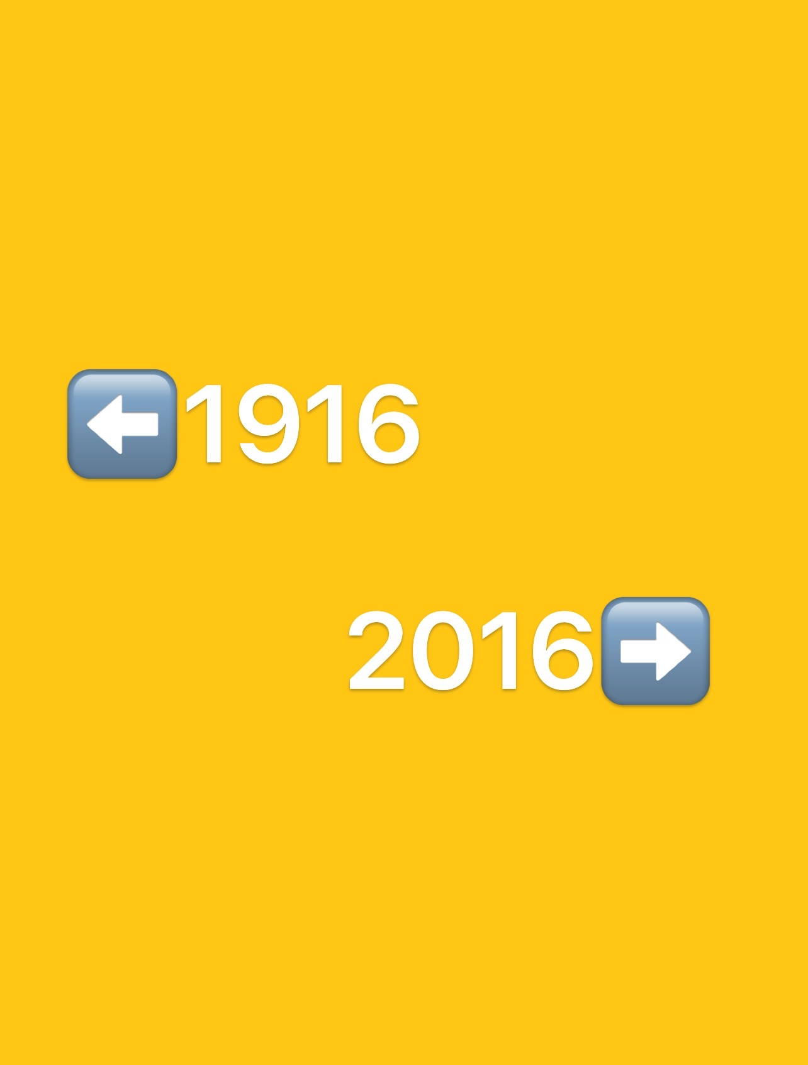
Presenting Difference
Nancy
Jason
Notes:
We present the difference between past and present by comparing two normal Carleton students’ lives in different timelines, who are Nancy and Jason respectively

Slide 5
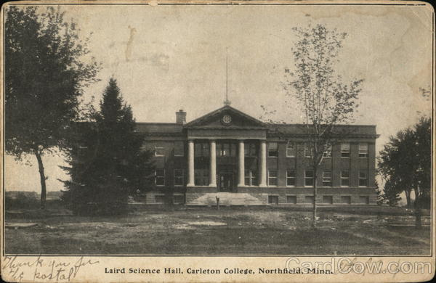
Building selection
Functionality
Presence
Notes:
To highlight the difference, we intentionally chose the building that are differed by functionality, or whether it is still present or not. For example, who can imagine that Laird Hall, a nowadays English department building used to serve natural sciences (like chemistry and biology)

Slide 6
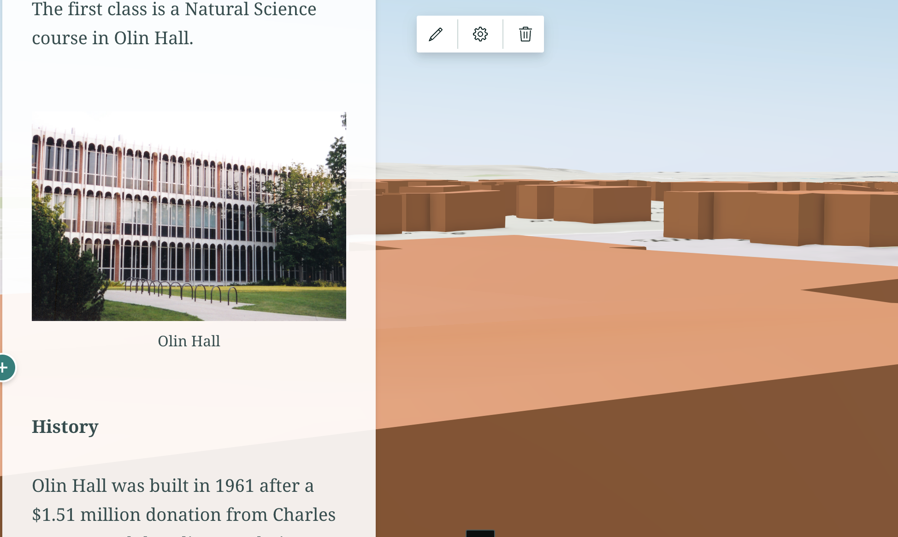
presentation
Narrative
Photo
Description
Notes:
In our planning, we wish to have a panel on the left where, as the users scroll down, the story map will change the building it presents accordingly. And the panel mainly has three components, narrative of what our protagonist does, the photo of the building, and its corresponding description.

Slide 7
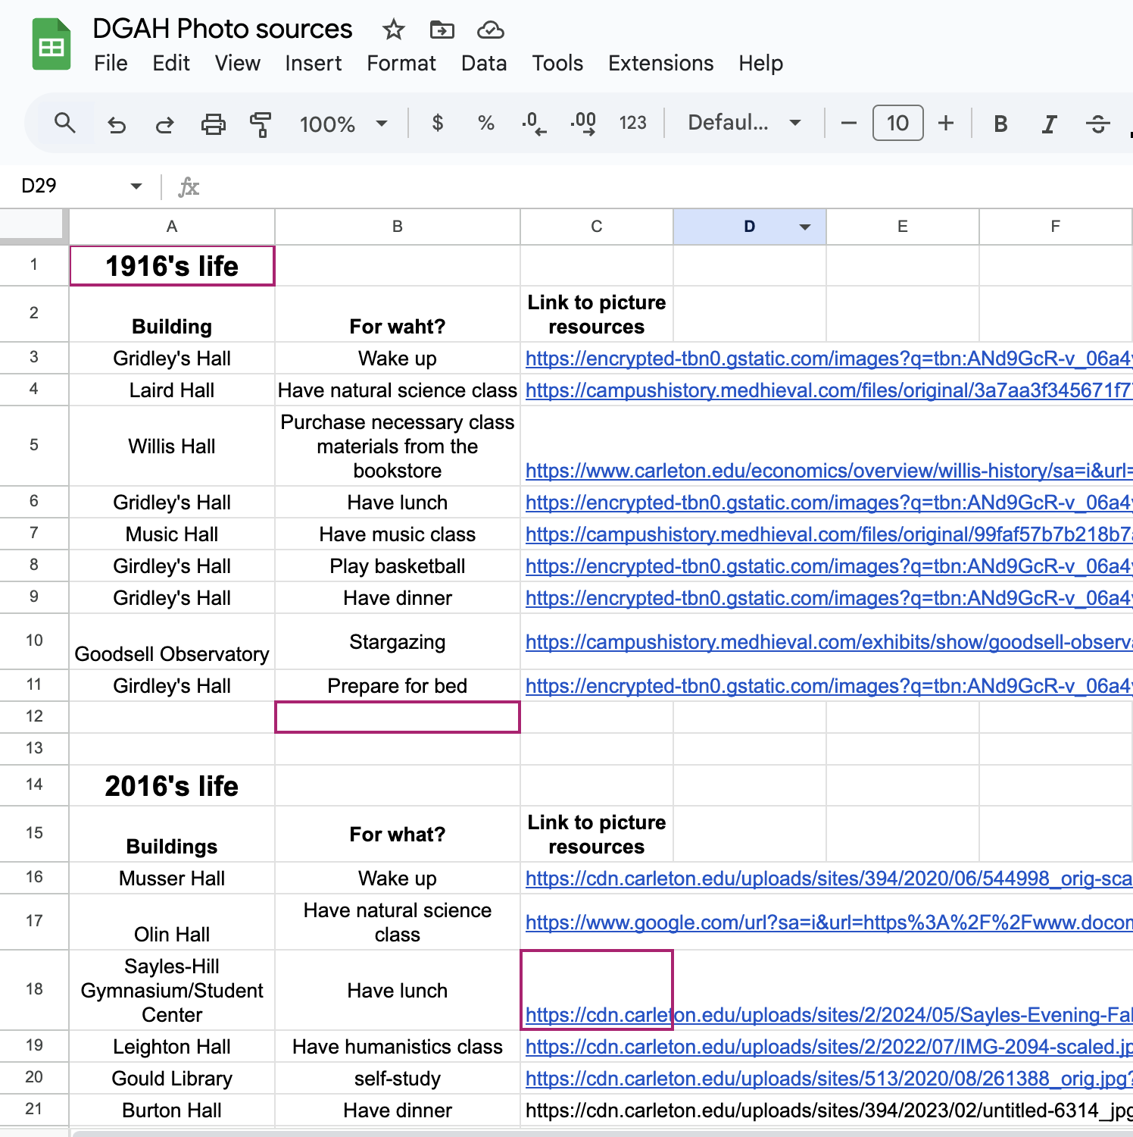
Preparation Process
Making up Narratives
Notes:
So, to prepare, we need to first come up with a reasonable narrative of what our protagonists do in a day. We made up the narrative of 2016’s life purely based on our own Carleton lives, and we made up the 1916’s one based with some research online, and we organized all the information in a spreadsheet.
Resources of the life in 1916: https://storymaps.arcgis.com/stories/f3188df08af54ae89a4491afd0143e81

Slide 8
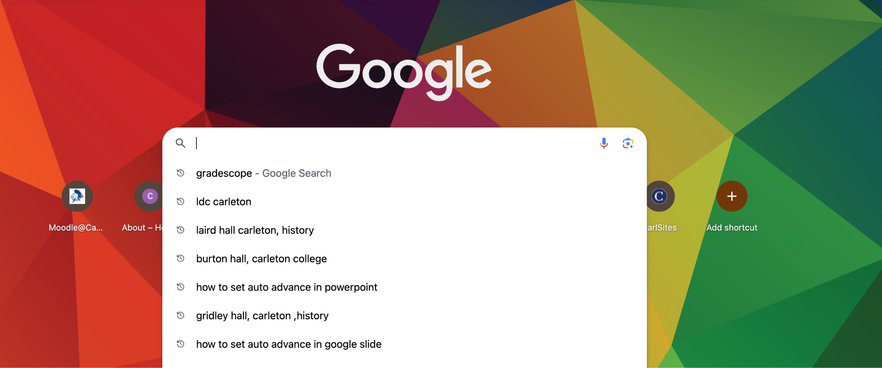
Building Description
Endless research & summary
Notes:
After the narratives, here comes the building description. For each building we include in our narrative, we used the keyword “the target hall, carleton, history” to search. And we summarized all the information we’ve searched for to write our own building description. (I have to say this is a torturous process)

Slide 9
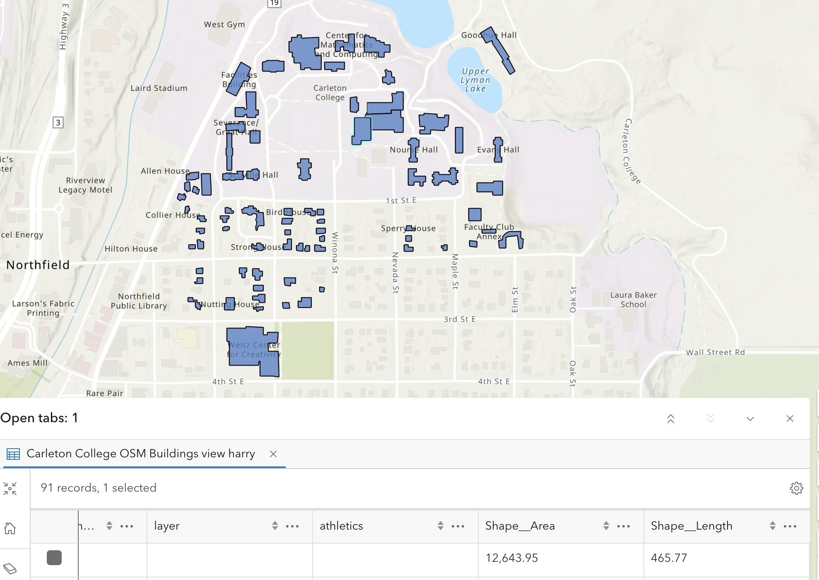
Selecting featured layers
Notes:
Now I am going to walk you through the 5 steps of making a story map. The first step is to select a featured layer. Featured layers are layers of a 2D map that gives the shape of buildings as well as attributes such as height or length.

Slide 10
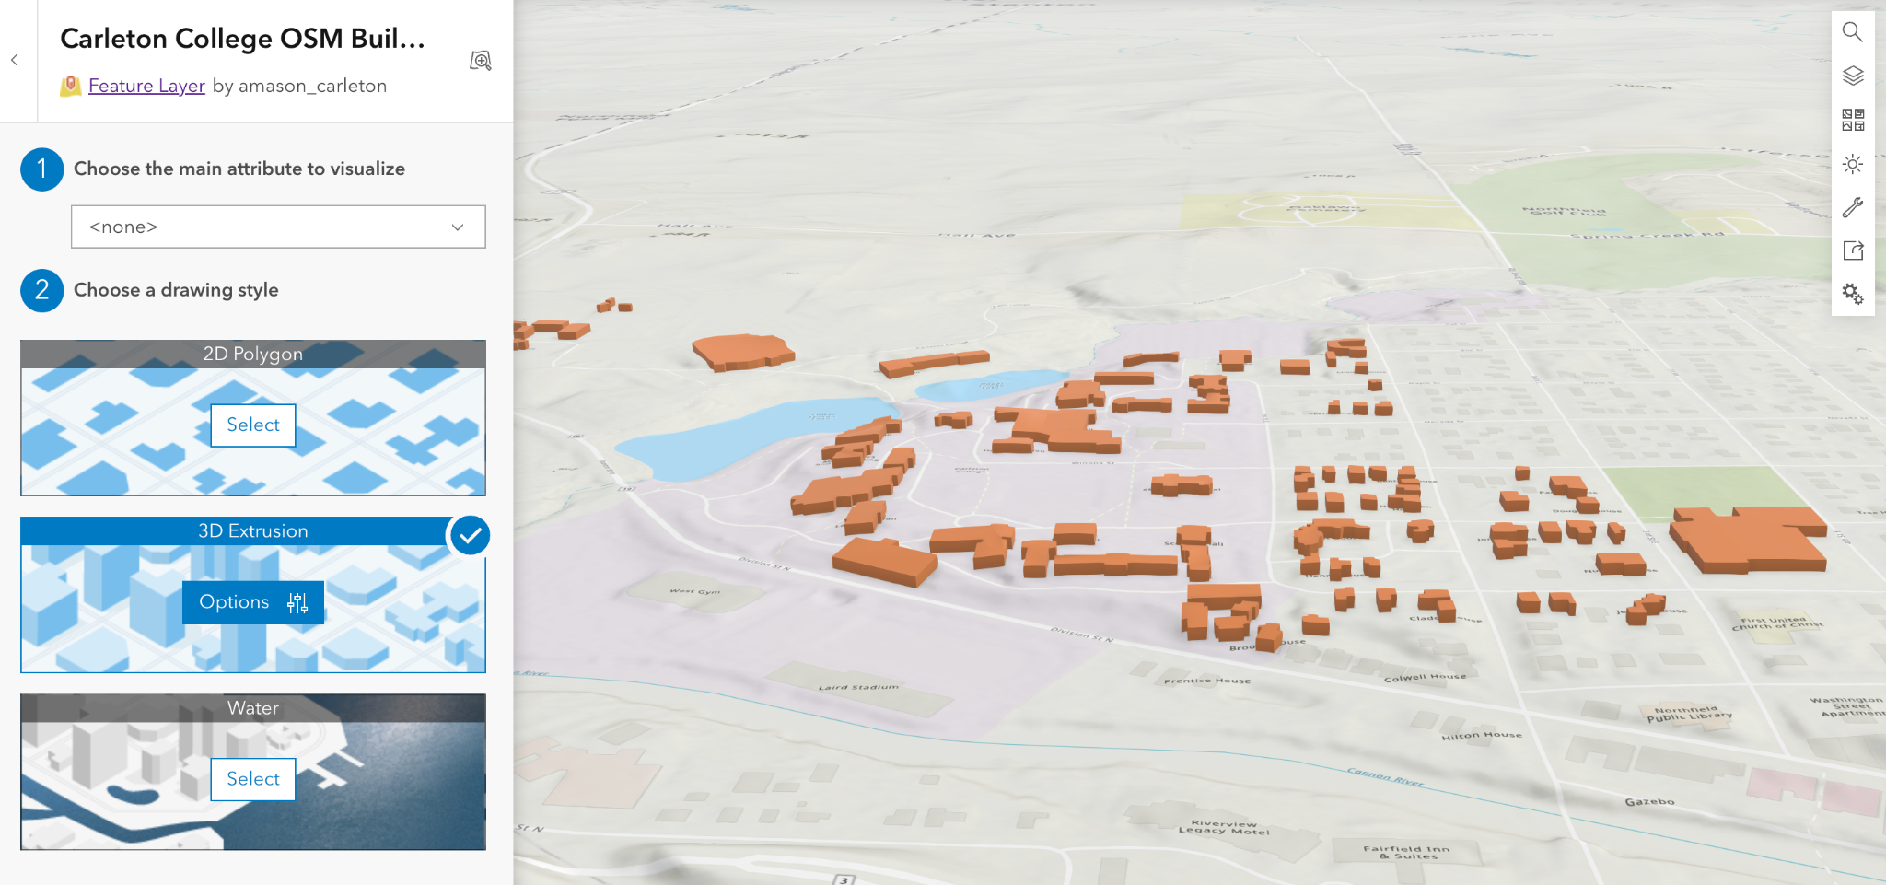
3D extrusion
Notes:
We could open the layer we choose in scene viewer, and when you click the layer button, this will occur. It allows you to do 3D extrusion based on the 2D shape of the building. But these 3D models are just boxes with the same height, so we will need to adjust it.

Slide 11
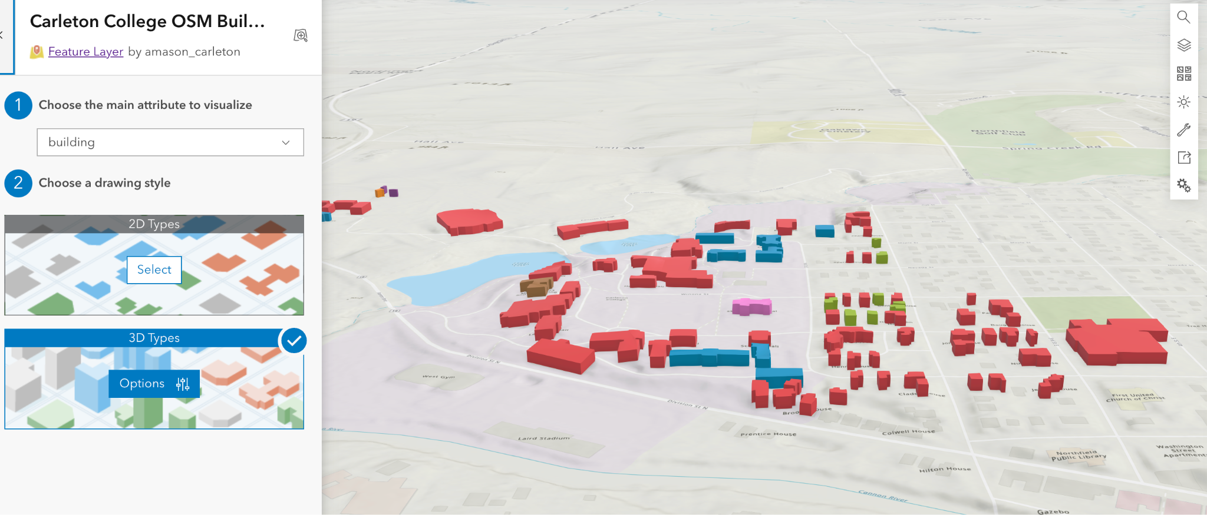
Fine-Tuning 3D mondel
Notes:
On the left of the scream the system allows us to adjust 3D models based on attributes. For instance, here I choose the function of the building as an attribute to adjust colours for each building. You can also use the height of the building to adjust the height of the 3D model.

Slide 12
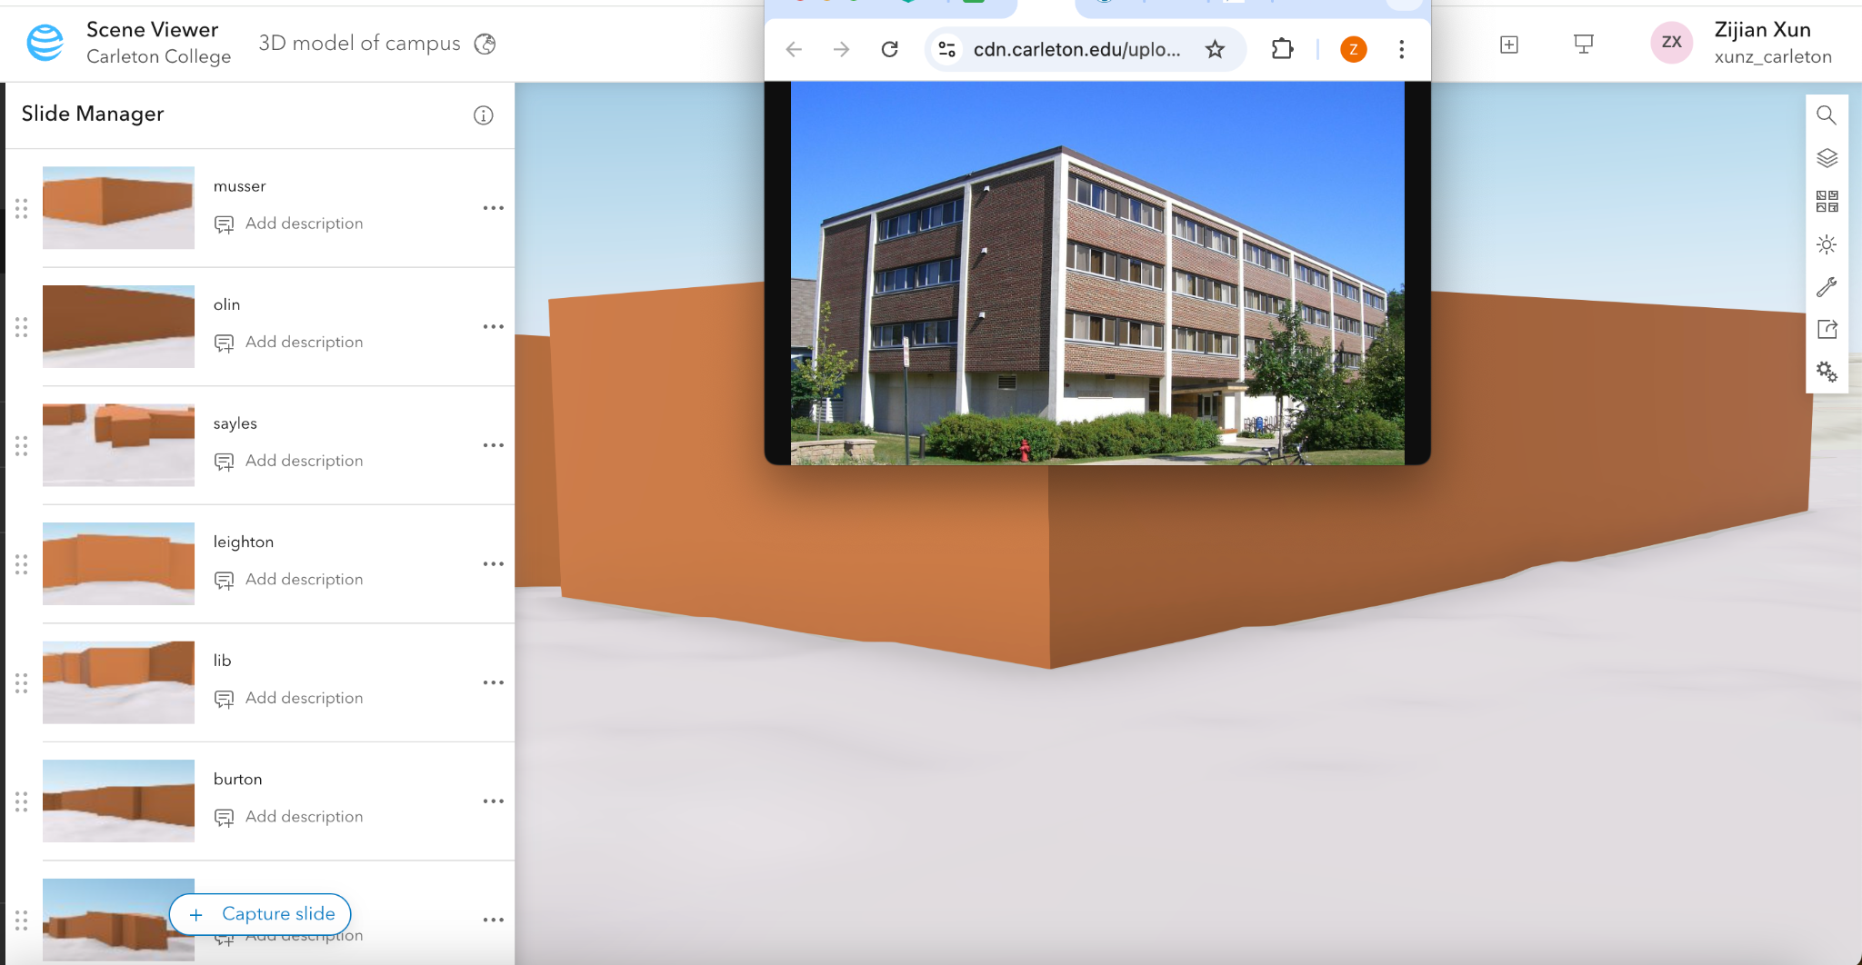
Making Slides
Notes:
After we finish our 3D model, we will need to make slide. Slides are like screenshots, so you will need to adjust your perspective based on the image you are looking at, and click the capture slide button. It will catch the screenshot of the view and saved locally.

Slide 13
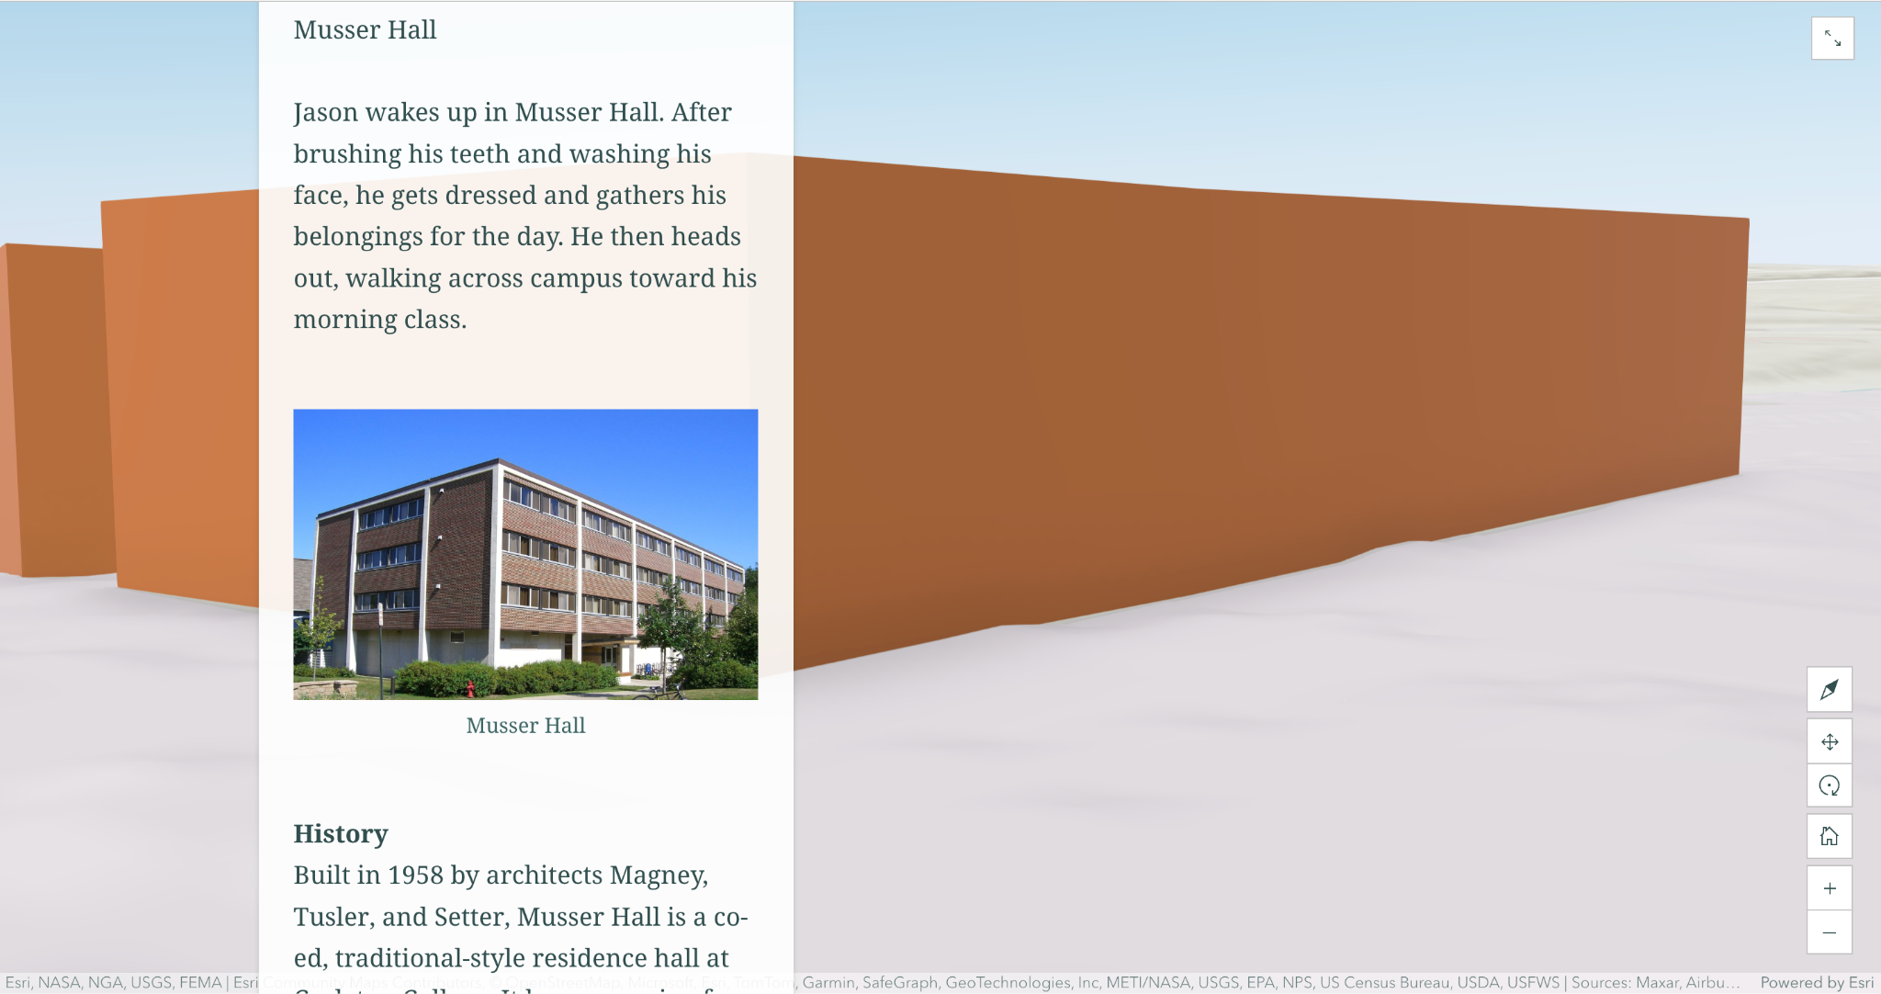
Making Storymaps
Notes:
After we have collected these slides, open the arcgis storymap and create a new one. Click the add map button, and it will allow you to choose any slide in the given map. Choose the slide you want, and put the text box as floating format. And everything is well set!

Slide 14
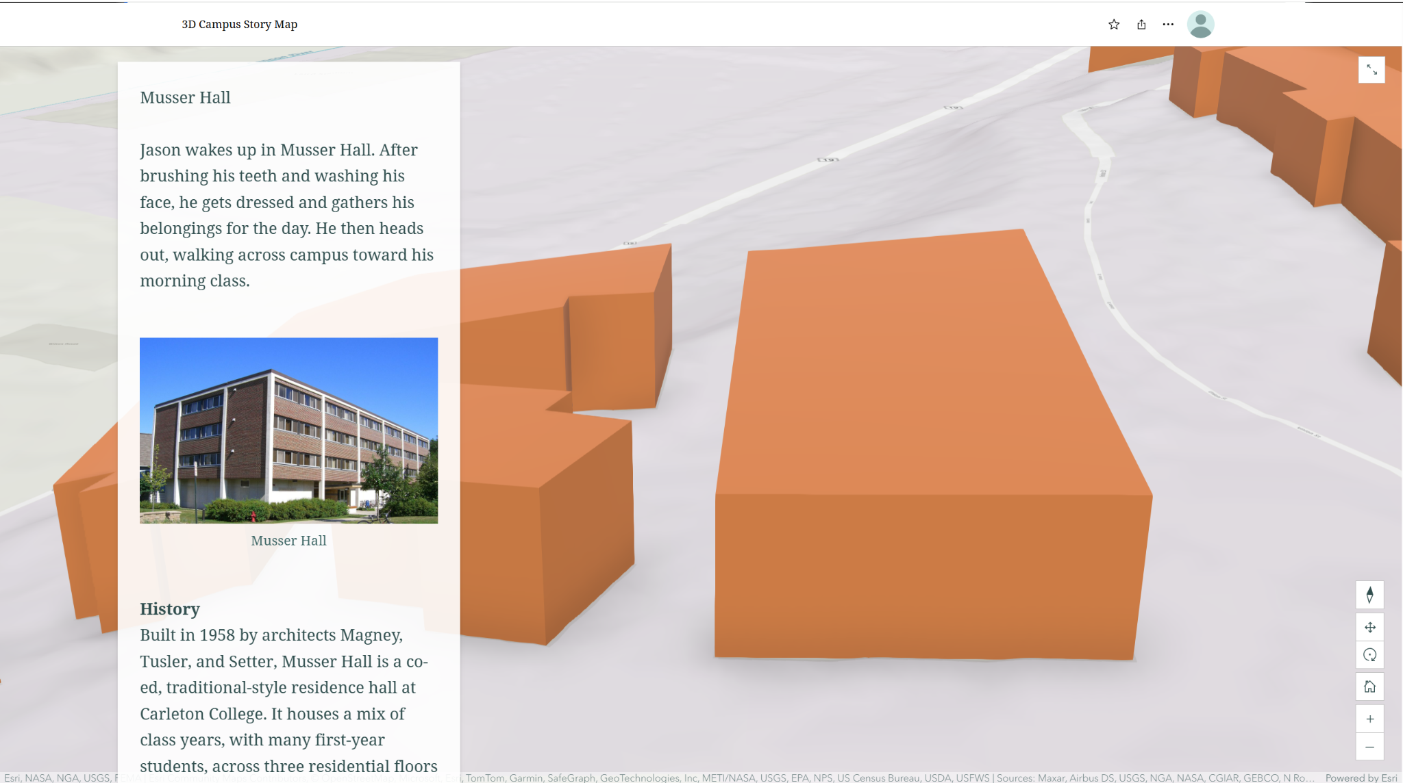
How to use story map

Slide 15
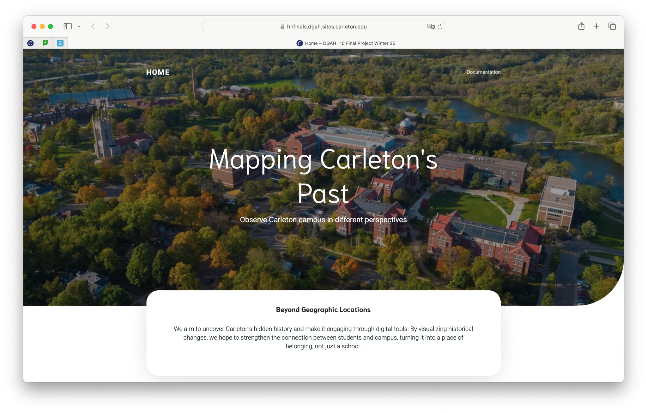
Building the Website by WordPress
Notes:
We build the website by WordPress. We adapted a theme at the beginning, and then customize it for our own use. The website included introduction to our inspiration, and the instruction of how to use the map.

Slide 16
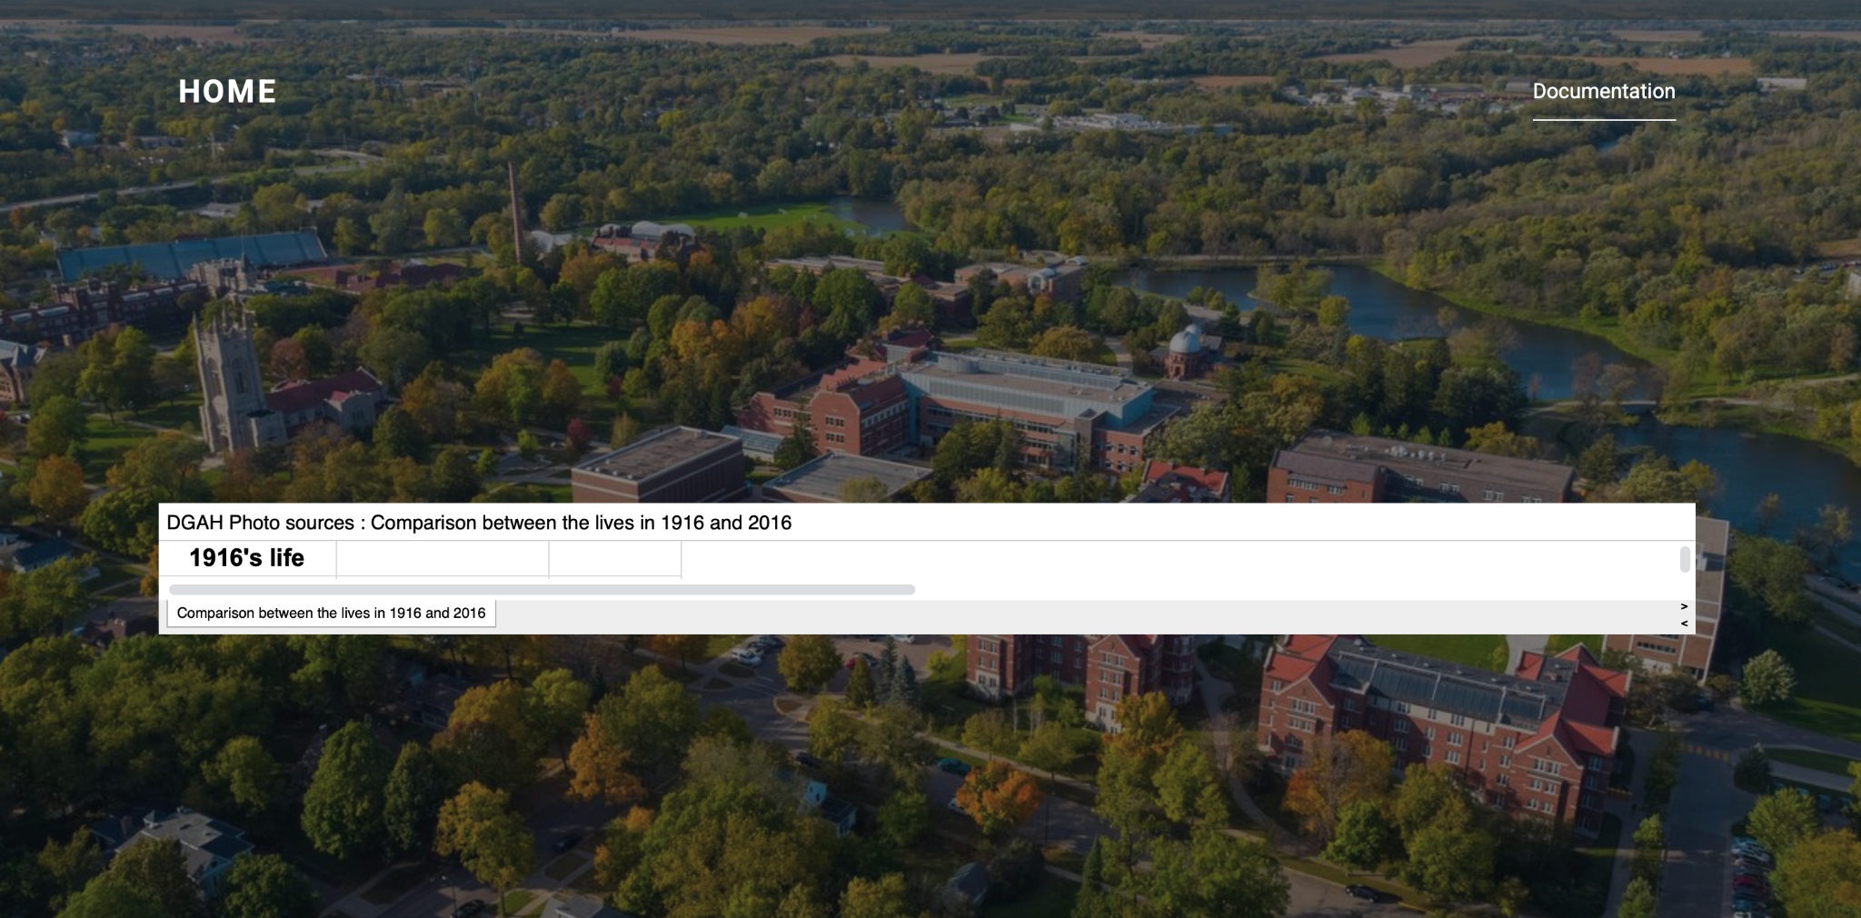
Documentation Page also Included
Notes:
ALso, we build the documentation page separately. This is because we want users be able to directly access the resources of the data we use, in case of they are interested to more detailed history due to playing with our map.

Slide 17
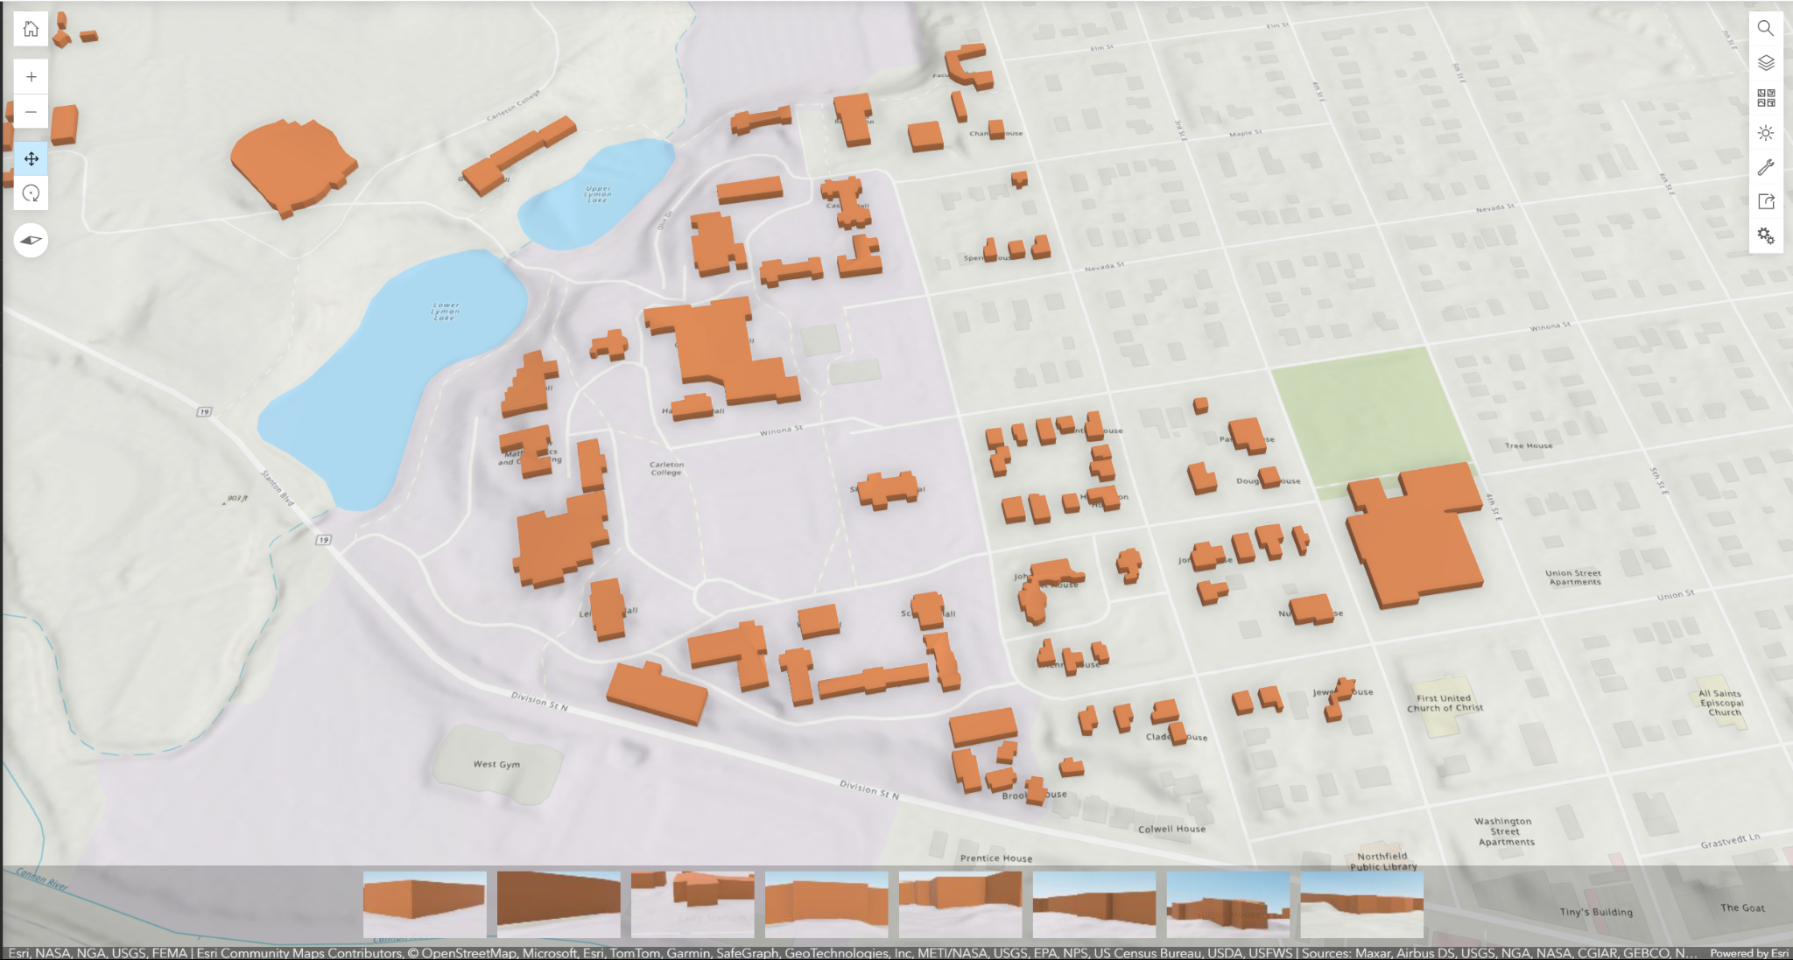
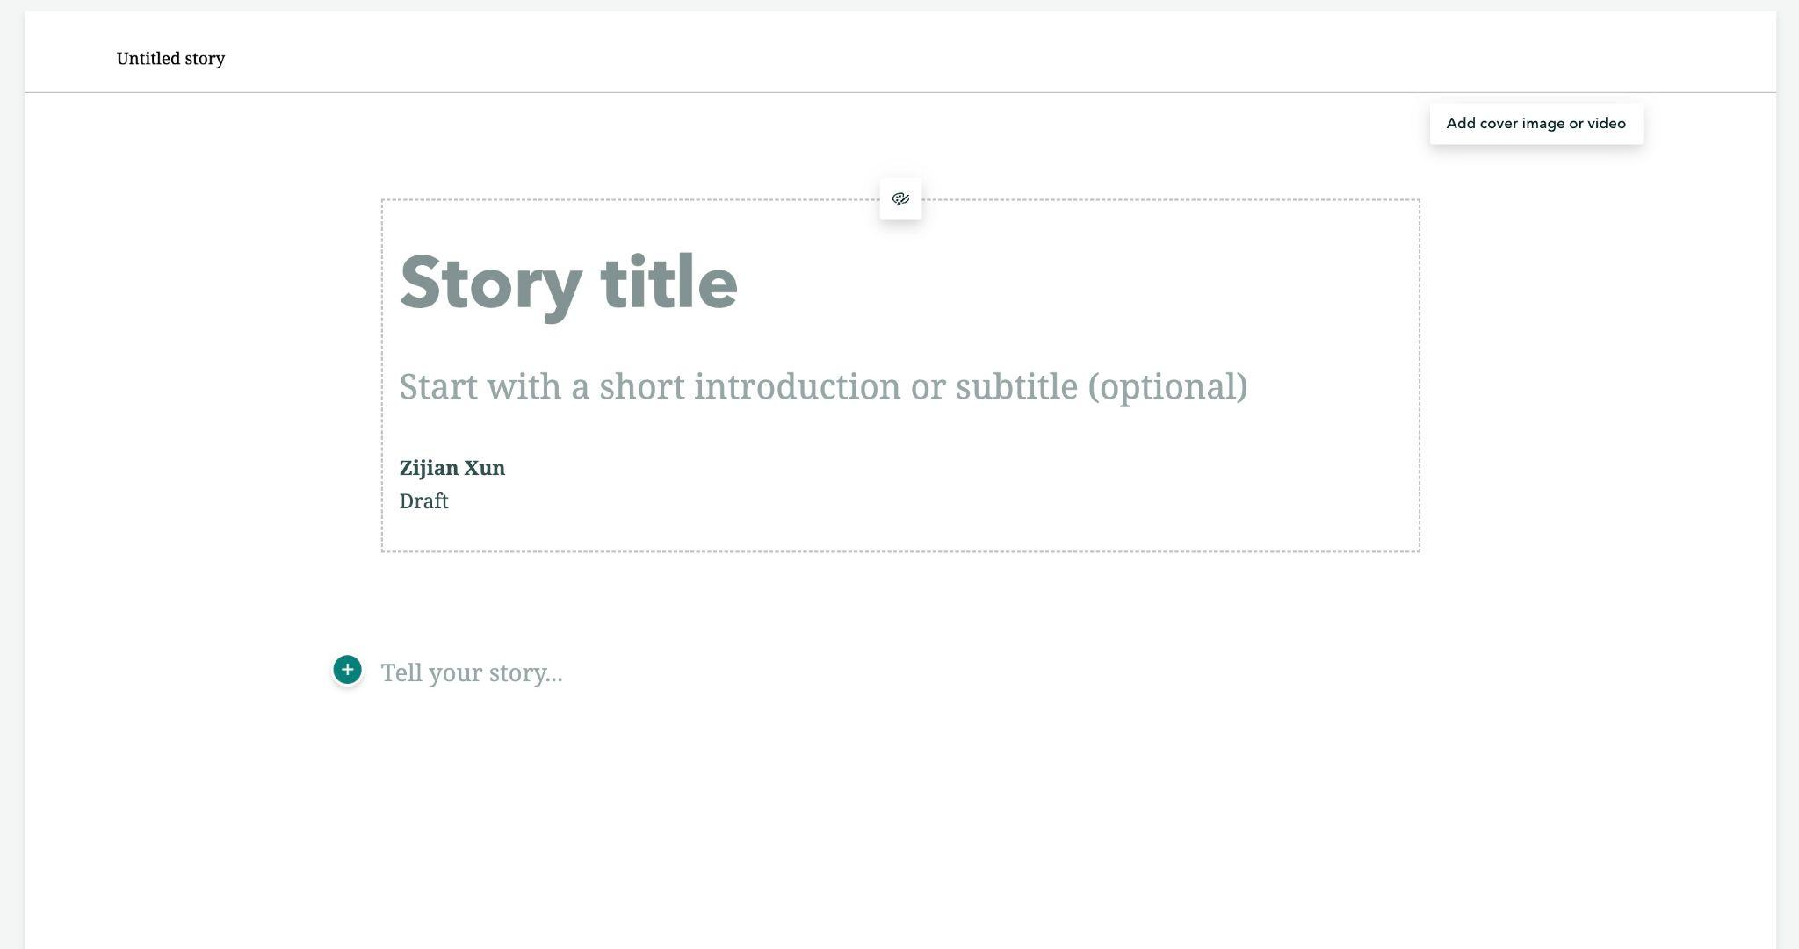
Challenges

Slide 18
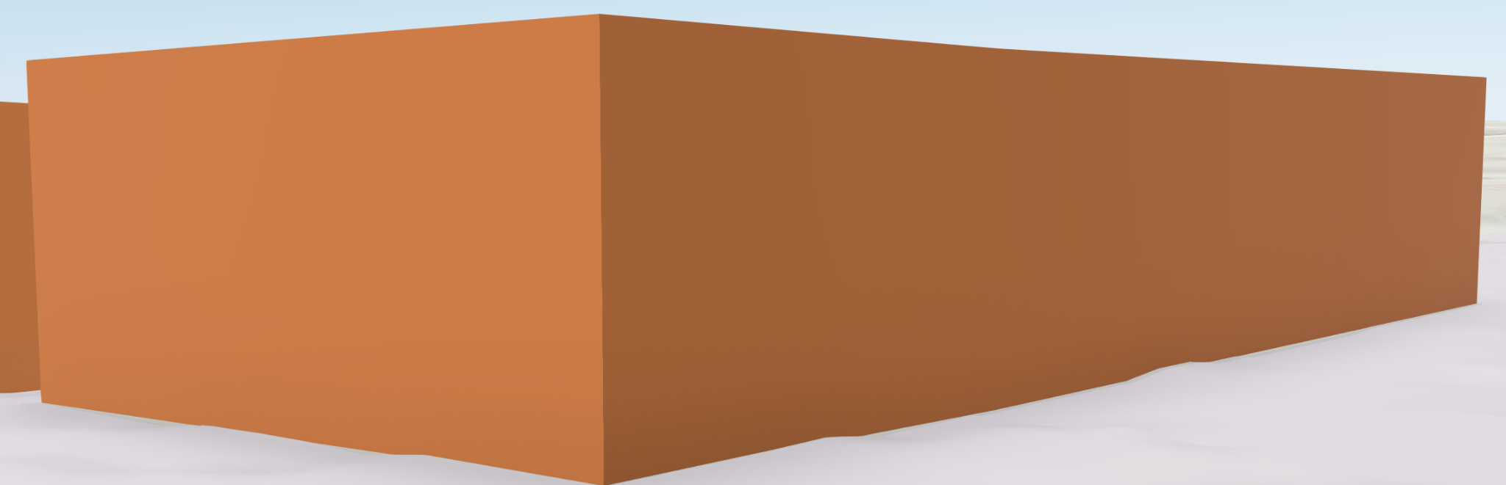
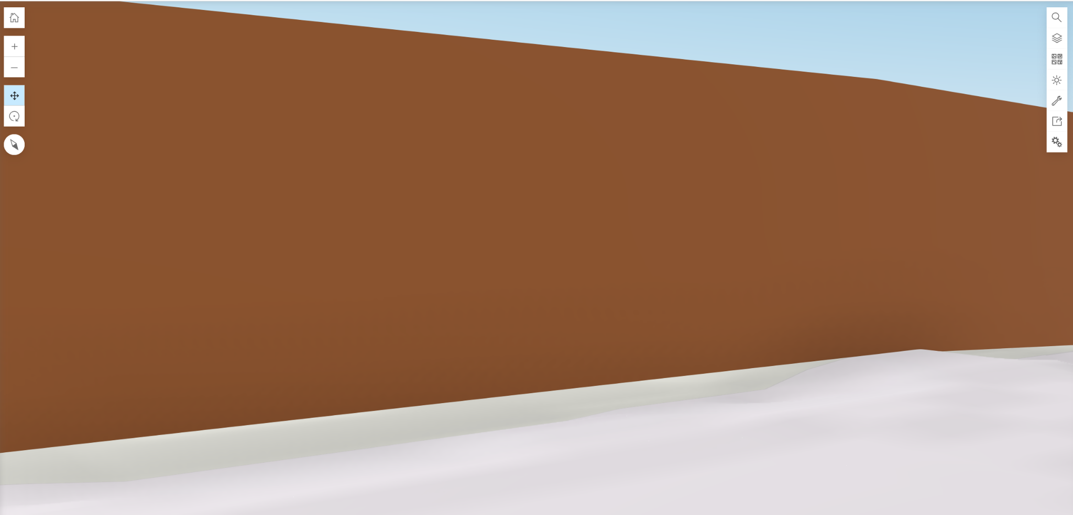
Improvements & Future enhancements

Slide 19
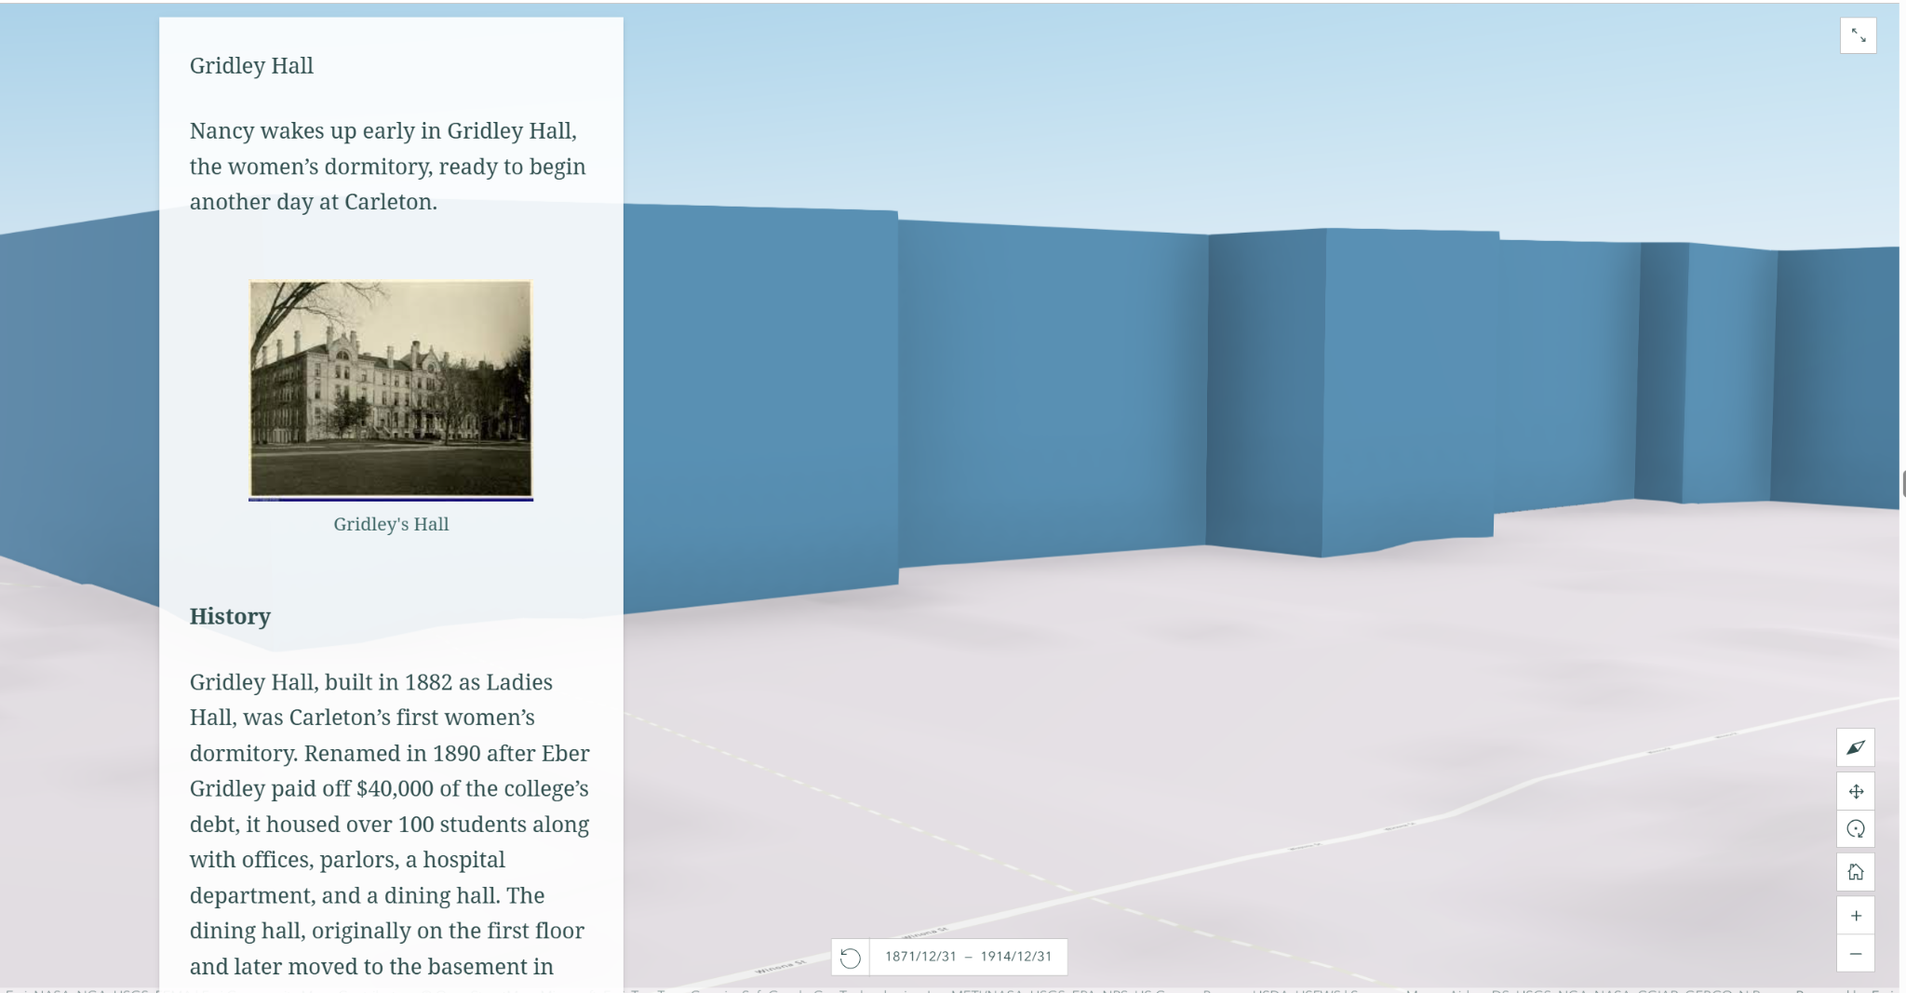
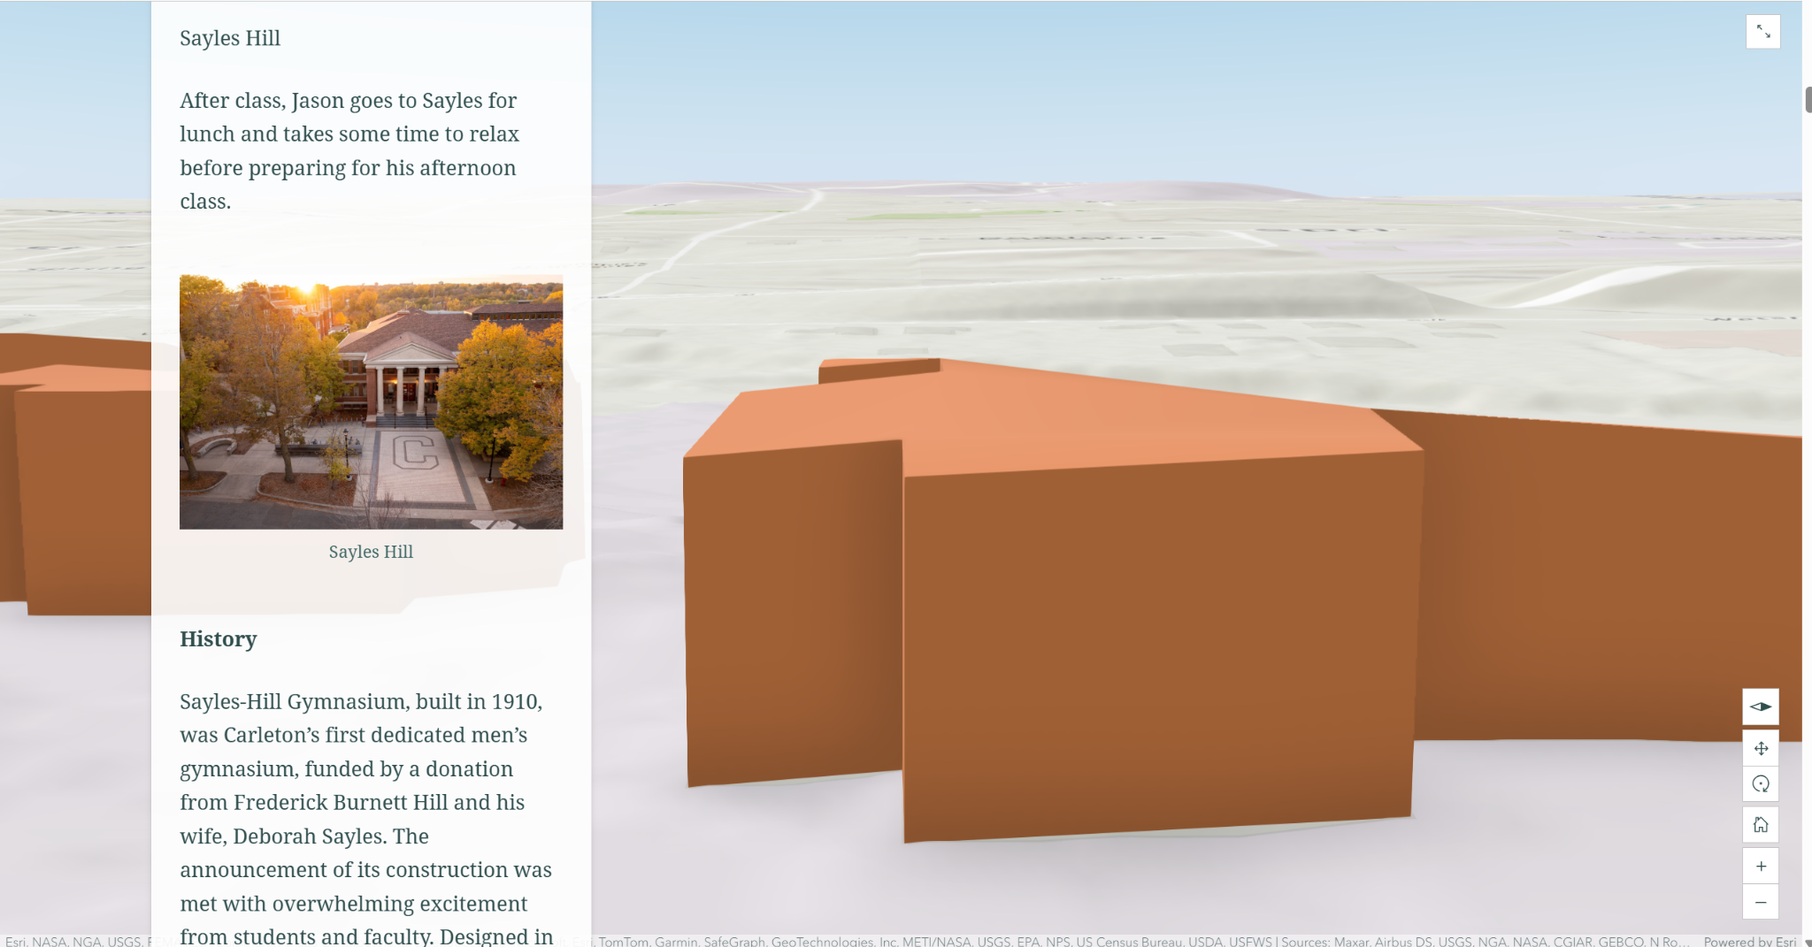
What makes our project unique?

Slide 20
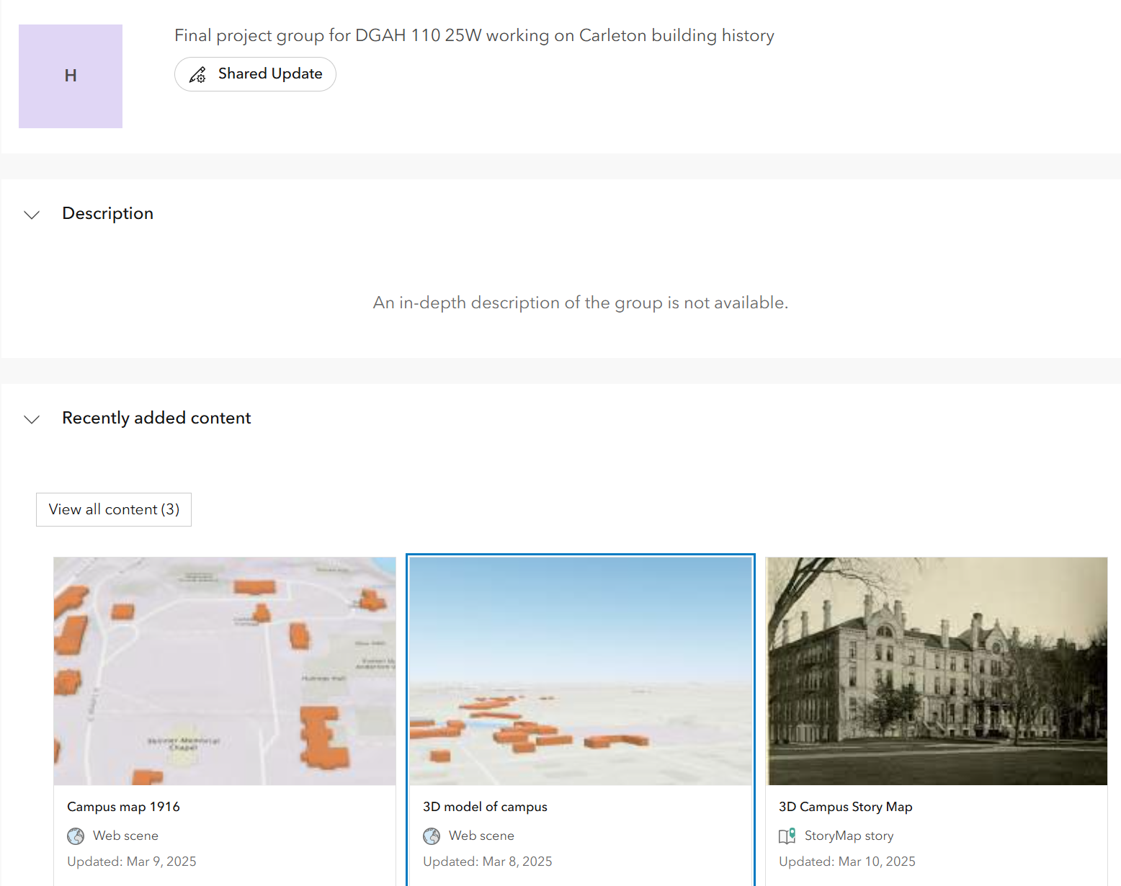
Reflections

